Slide 1

GEOG 4/590: Geospatial Data Science
Code review: Assignment 3 and 4
Email: jryan4@uoregon.edu
Office: 163A Condon Hall
Office hours: Mondays 14:00-16:00

Slide 2
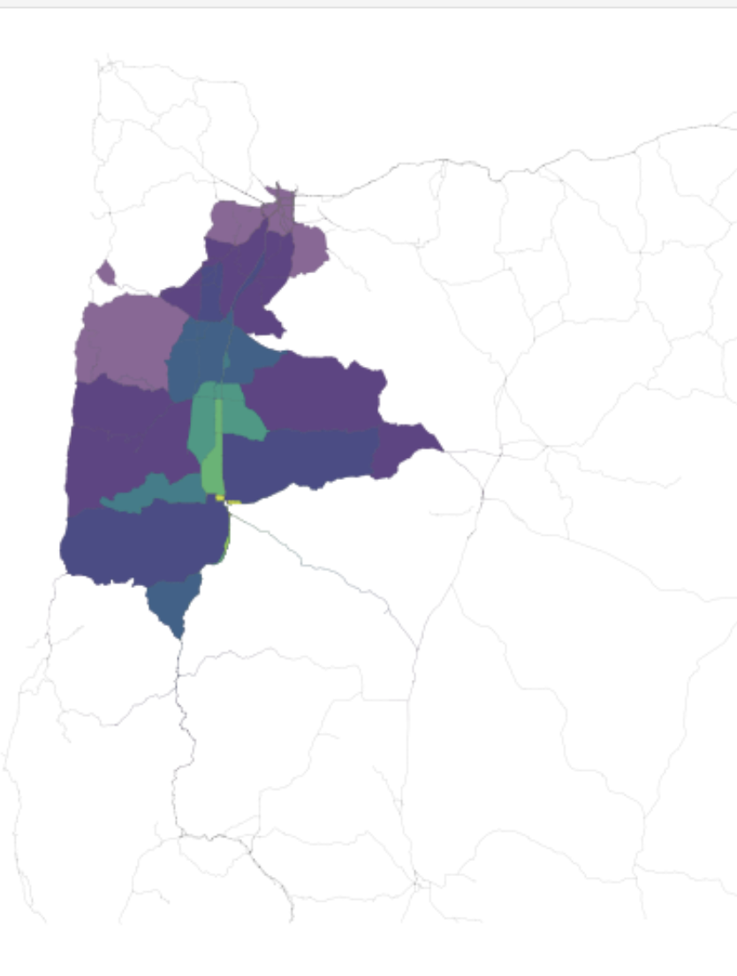
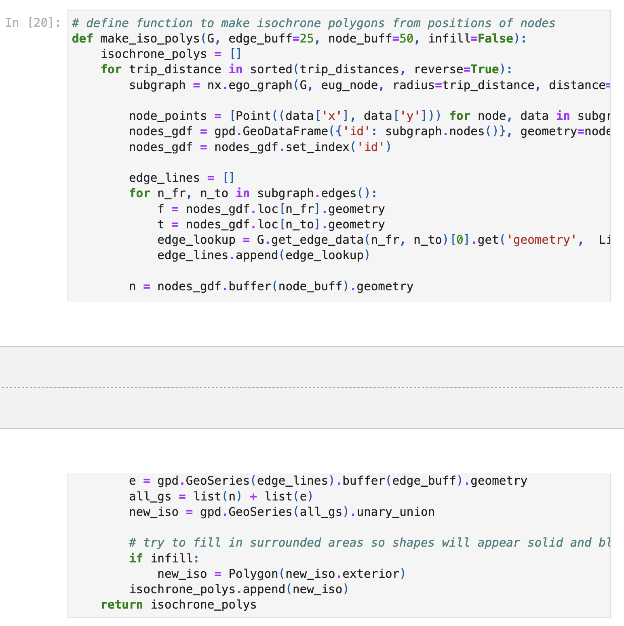
Assignment 3: Task 3
Notes:
How many cities in Oregon are within a 2 hour drive of Eugene (at 60 mph)? Answer should be 124 if using isochrones or 179/181 if using node solution.

Slide 3
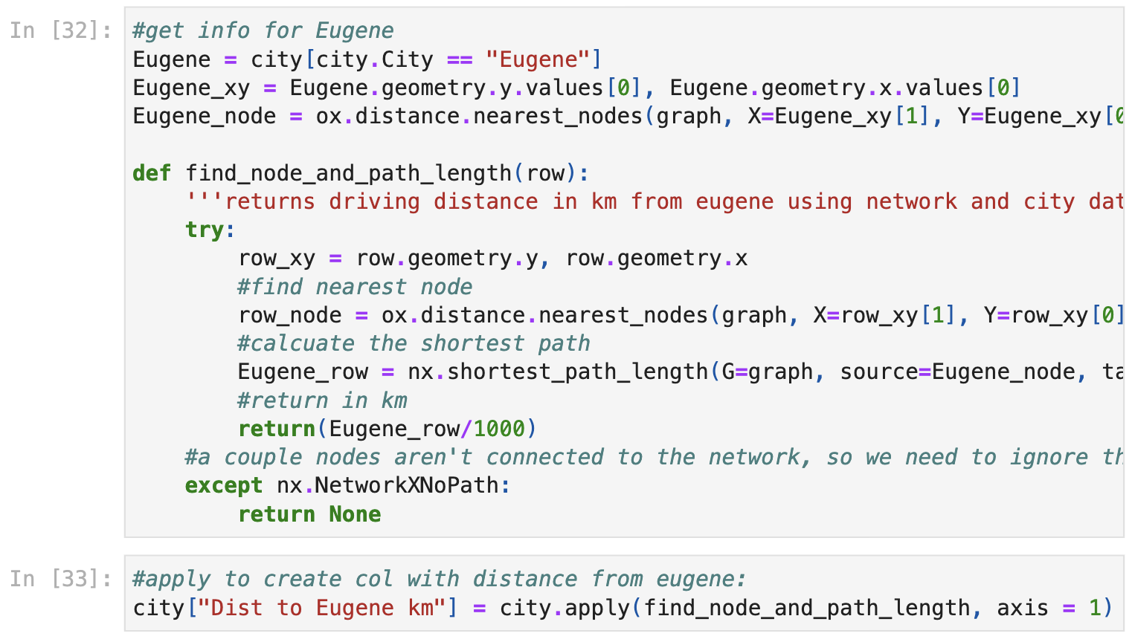
Assignment 3: Task 3
Notes:
How many cities in Oregon are within a 2 hour drive of Eugene (at 60 mph)? Answer should be 124 if using isochrones or 179/181 if using node solution.

Slide 4
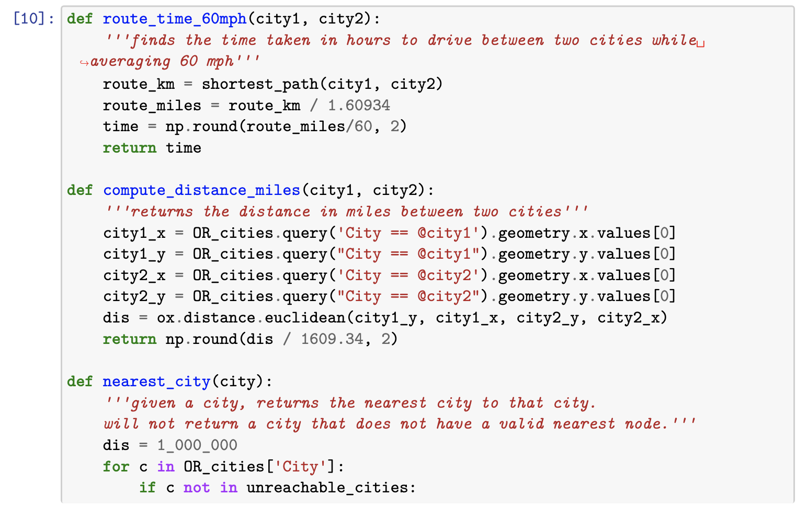
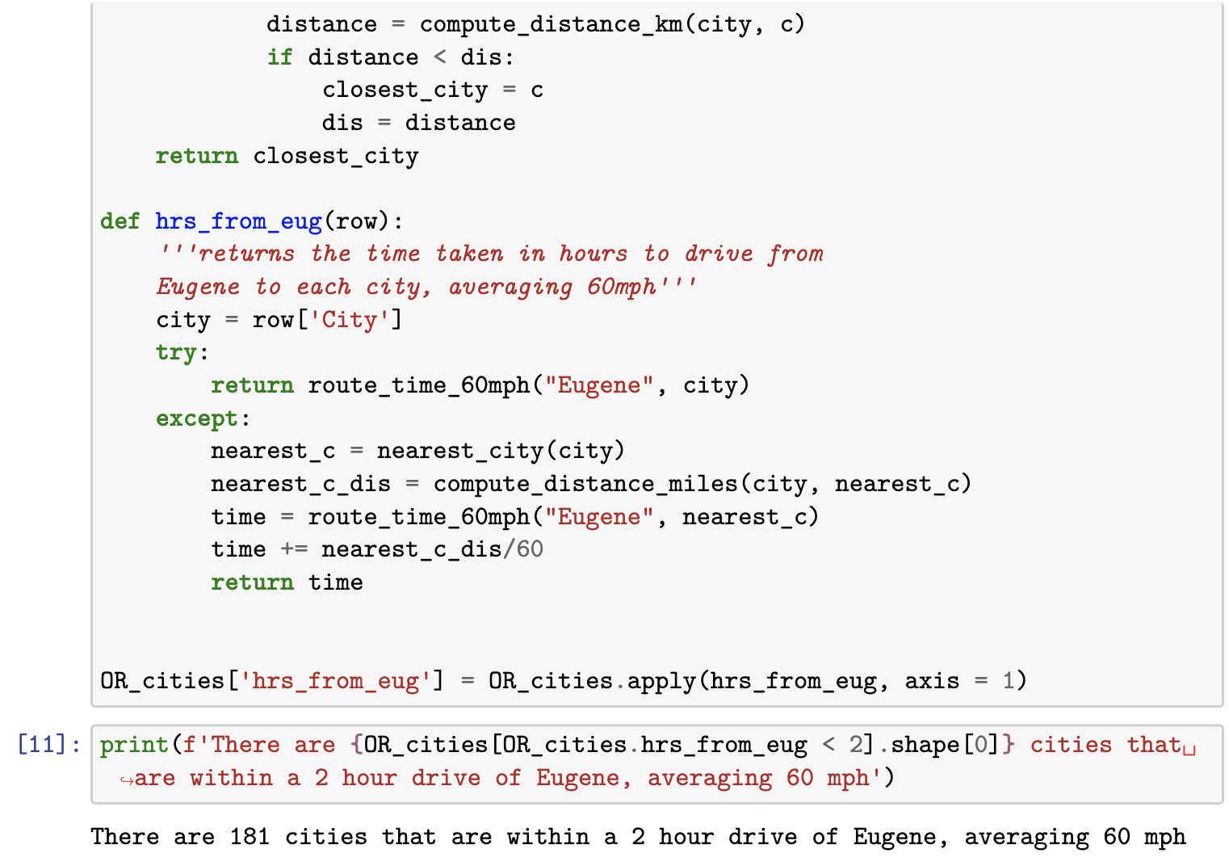
Assignment 3: Task 3
Notes:
How many cities in Oregon are within a 2 hour drive of Eugene (at 60 mph)? Answer should be 124 if using isochrones or 179/181 if using node solution.

Slide 5
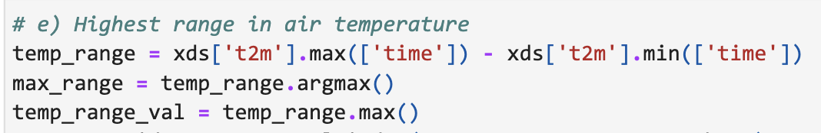
Assignment 4: Task 6e
Notes:
Highest range in air temperature

Slide 6
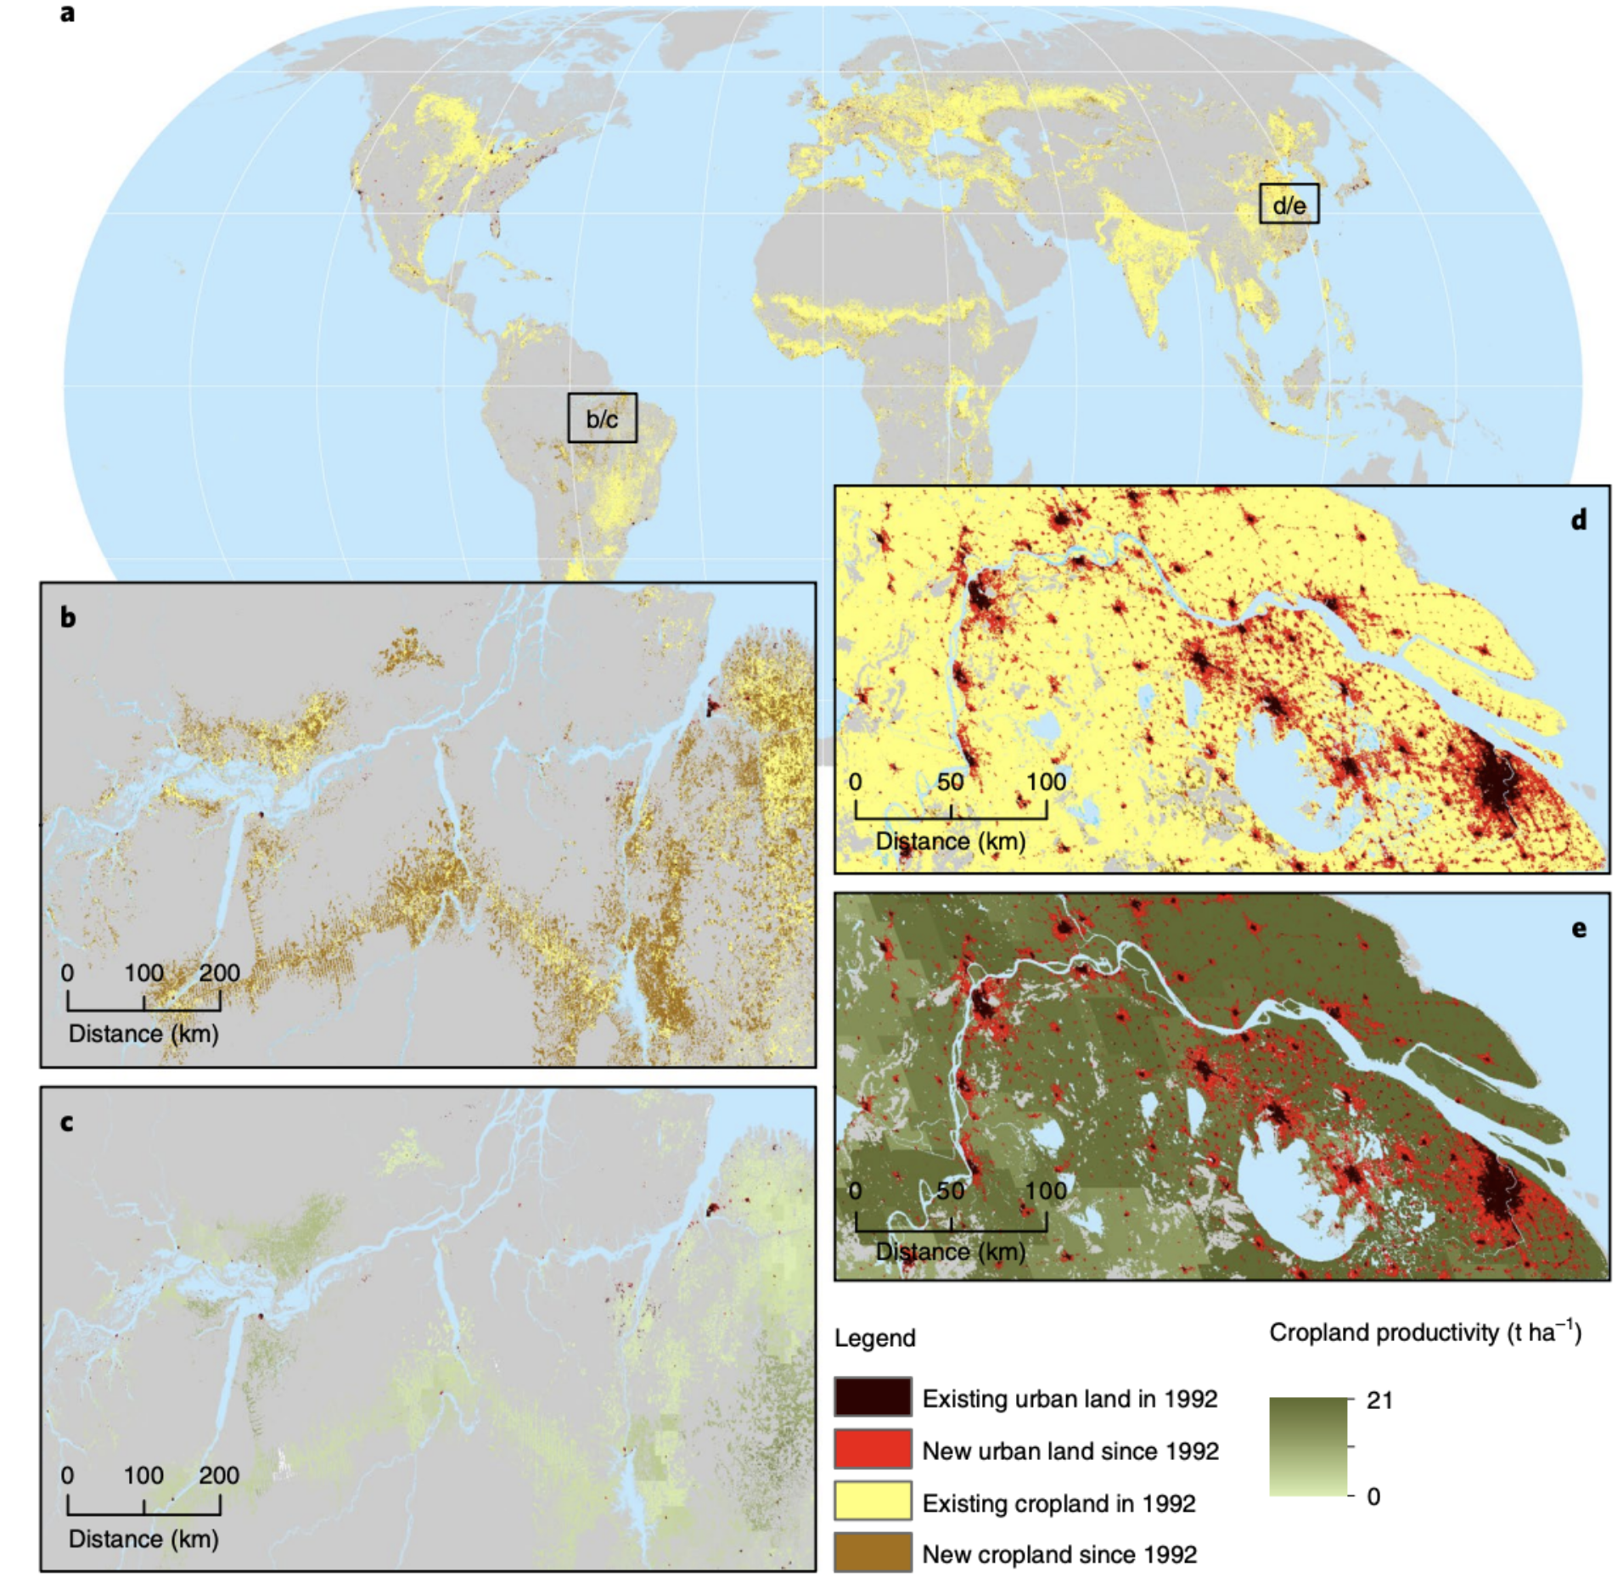
Assignment 4: Task 4
Notes:
Urban expansion and cropland between 1992 and 2015 – Nature Sustainability

Slide 7
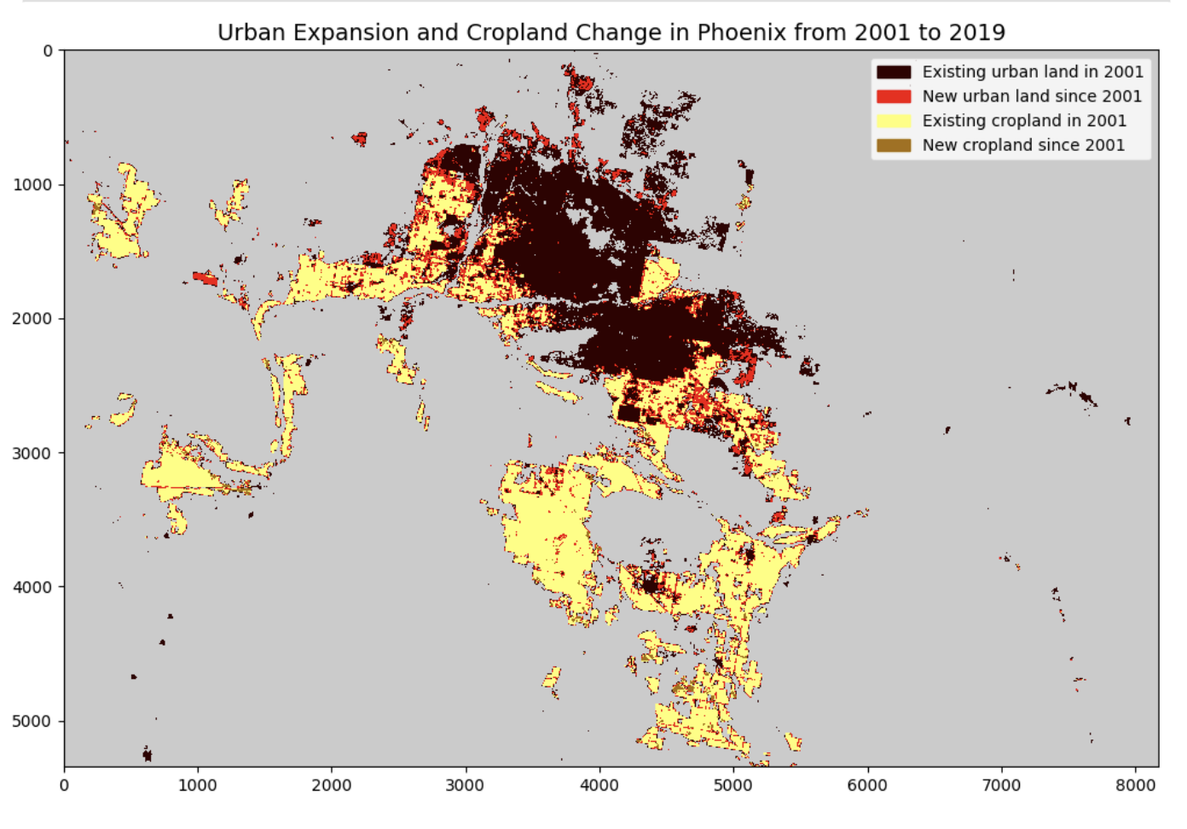
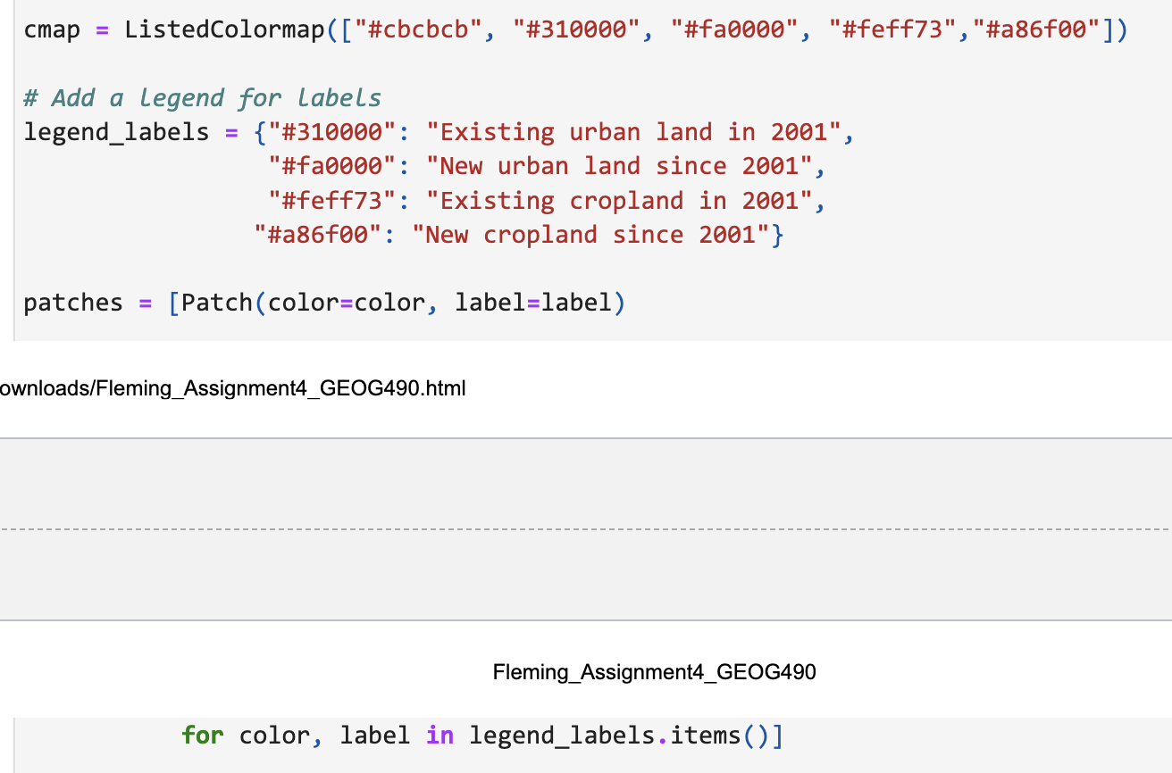
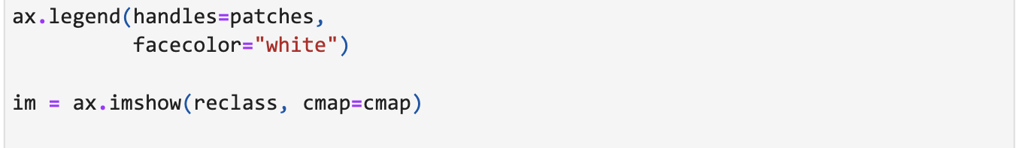
Assignment 4: Task 4
Notes:
Urban expansion and cropland between 1992 and 2015 – Nature Sustainability

Slide 8
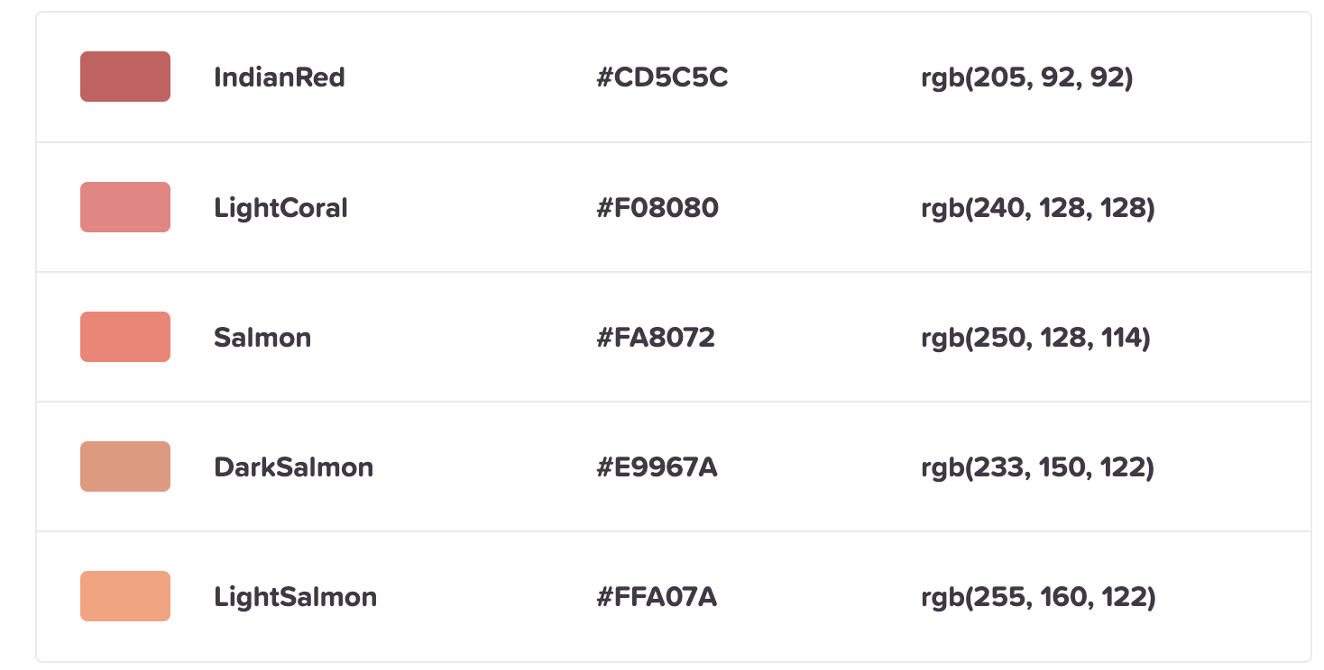
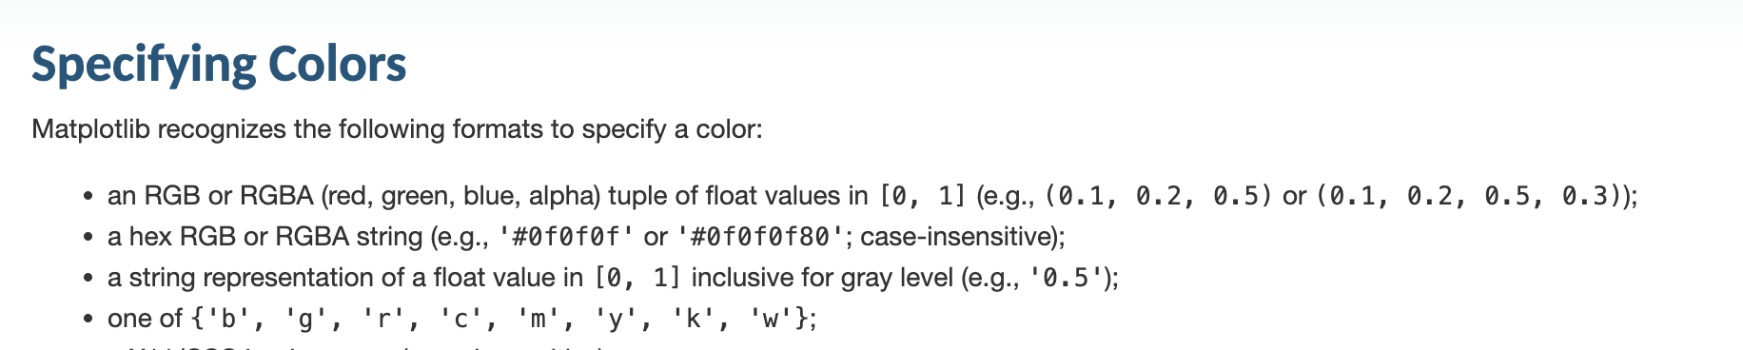
Assignment 4: Task 4
https://matplotlib.org/3.1.1/tutorials/colors/colors.html
Notes:
Urban expansion and cropland between 1992 and 2015 – Nature Sustainability

Slide 9
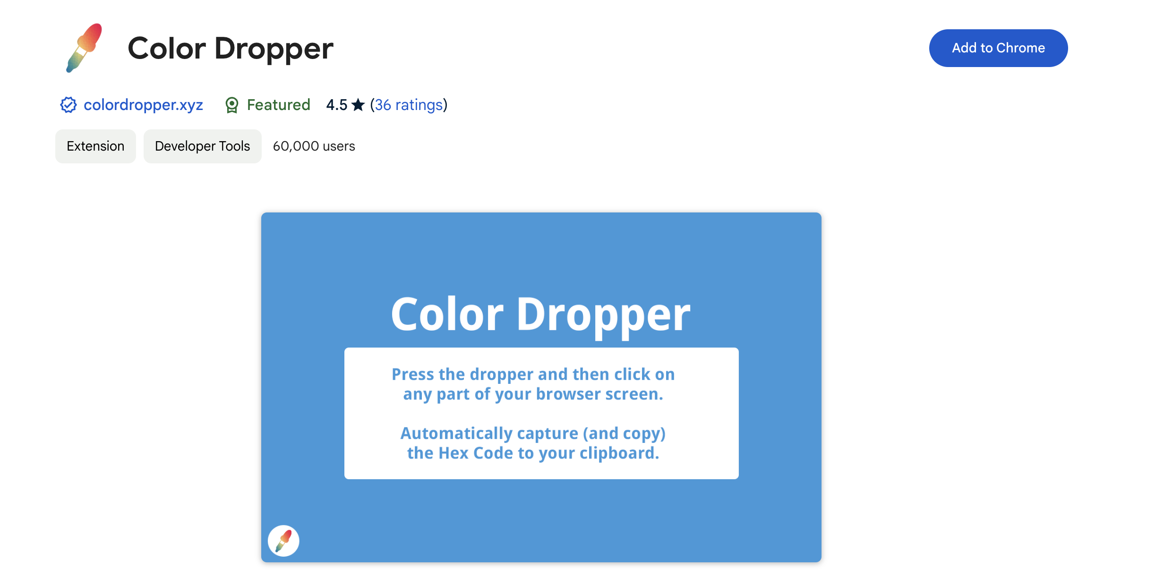
Assignment 4: Task 4
Notes:
Urban expansion and cropland between 1992 and 2015 – Nature Sustainability

